Slide 1
Tasdeeq – Digital Verification Platform Kickoff
Prepared By: Fazeel Ahmed
26/01/2026
Project Kickoff Meeting
Notes:
Good morning everyone.
Thank you for attending the kickoff meeting for the Tasdeeq Digital Verification Platform.
My name is Fazeel Ahmed, and today I will explain what the project is about, what we plan to deliver, how we will manage it, and the overall timeline and budget.

Slide 2
Introduction
Tasdeeq is a secure digital verification platform that enables organizations in the Italy and EU region to perform identity and credential verification while ensuring GDPR-compliant data handling.
Notes:
Tasdeeq is a digital platform designed to help organizations verify people’s identities and credentials in a secure and reliable way.
The platform is intended for use in the Italy and EU region and is designed to follow GDPR regulations, ensuring that personal data is handled safely and legally.

Slide 3
Agenda
Project Overview
Project Scope
Goals
OBS
Customers
Major Deliverables/Project Timeline
Communication Plan
Budget and Resources
Milestones
Risk Management
EVA Analysis
Notes:
During this presentation, I will briefly cover the project overview, scope, goals, organization, target customers, timeline, budget, communication plan, risk management, and economic value of the project.
This will give a complete picture of how the project will be executed.

Slide 4
Project Overview
The Tasdeeq Digital Verification Platform project aims to develop a secure and reliable digital verification application to support identity and credential verification for organizations.
This project involves in-house development, leveraging existing technologies and infrastructure to deliver a GDPR-compliant, high-quality platform within an approved €180,000 budget.
Key Features
Identity Verification – Validates an individual’s identity using official documents
Credential Verification – Verifies education, employment, and professional credentials
GDPR-Compliant Data Handling – Ensures privacy, consent management, and lawful data processing
Role-Based Access Control – Restricts system access based on user roles and responsibilities
Audit Logs & Monitoring – Maintains traceable records of all verification activities
Notes:
The goal of the Tasdeeq project is to build a secure digital verification platform that organizations can trust.
The project will be developed in-house, using existing technologies and development tools.
The total approved project budget is €180,000, and the platform will be designed to meet both technical quality and regulatory compliance requirements.

Slide 5
Project Scope
In Scope:
Development of Backend and Frontend System
API integration with external verification and enterprise systems
Secure user authentication and authorization mechanisms
Easy to use User interface and experience design
Notes:
The project scope includes the development of the core verification system, both backend and frontend.
It also includes secure user authentication, API integration with external systems, and the design of a user-friendly interface for enterprise and administrative users.
Activities outside this scope, such as long-term operational support, are not included.

Slide 6
Goals
Establish Tasdeeq as a trusted digital verification solution for organizations in the Italy and EU region
Support regulatory compliance and reduce fraud risk for enterprise clients
Strategic
Goals
Develop a secure, scalable, and API-driven verification platform
Ensure high availability, performance, and data security in compliance with GDPR
Technical
Goals
Economic Goals
Keep development costs low while ensuring good quality
Recover the investment within the first year after launch
Notes:
From a strategic perspective, the goal is to provide organizations with a trusted verification solution.
From a technical perspective, the platform must be secure, scalable, and reliable.
From an economic perspective, the project aims to control costs while delivering a high-quality solution that creates long-term value.

Slide 7
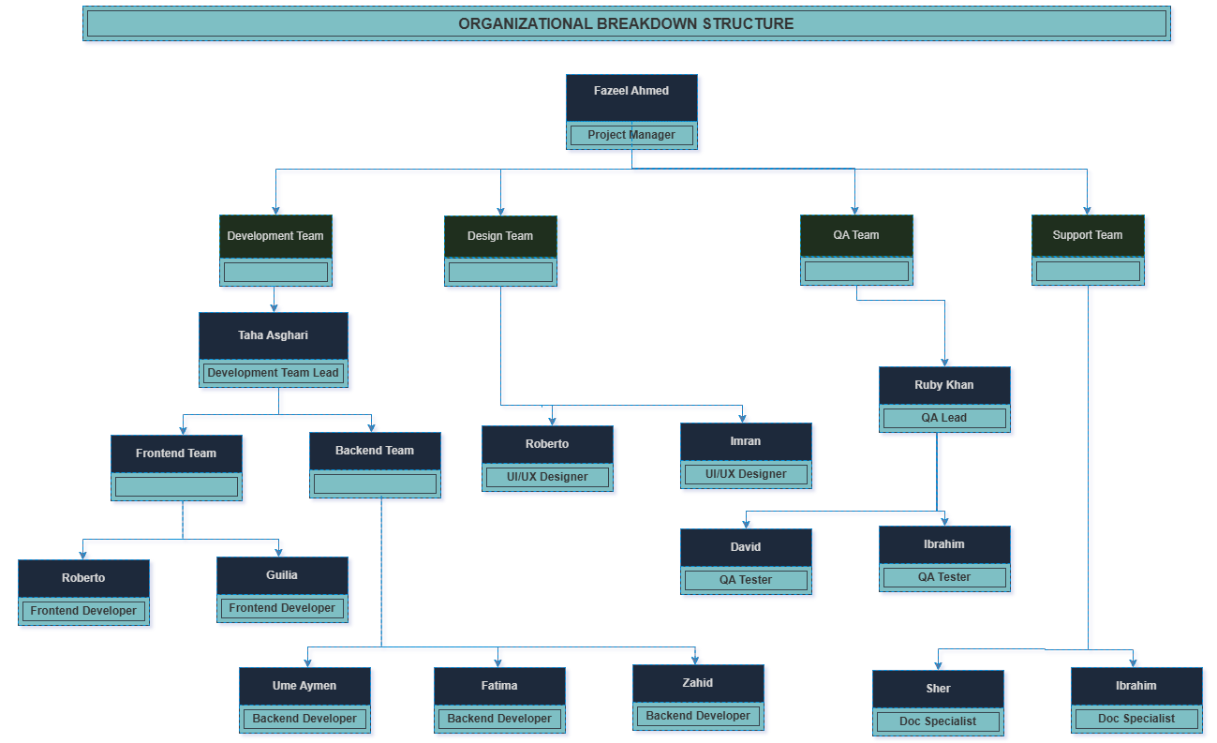
Organization Breakdown Structure
Notes:
The Organizational Breakdown Structure defines who is involved in the project and how responsibilities are assigned.
It ensures clear communication between the Project Manager, development team, and stakeholders, helping avoid confusion and overlapping responsibilities.

Slide 8
Customers
Target Customers
Organizations requiring secure digital identity and credential verification
Employers and HR firms performing background and credential checks
Banks, fintech companies, and telecom operators requiring customer verification
Public and semi-public institutions operating in the Italy and EU region
Notes:
The Tasdeeq platform is aimed at organizations that require digital verification services.
These include employers performing background checks, banks and fintech companies verifying customers, and public or semi-public institutions operating in the Italy and EU region.

Slide 9
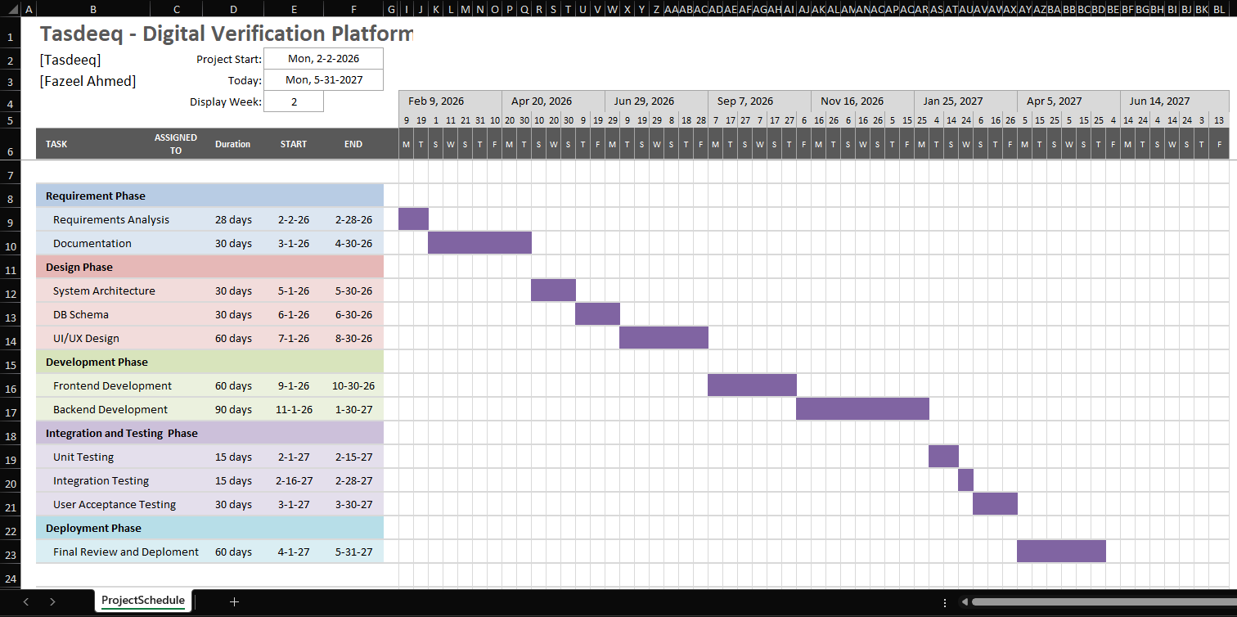
Major Deliverables/ Project Timeline
Notes:
The project follows a phased approach, starting with requirements and planning, followed by design, development, integration, testing, and final deployment.
Each phase has clear deliverables, allowing progress to be monitored and controlled effectively.

Slide 10
Communication Plan
Internal Communication:
Weekly project status meetings with key stakeholders
Daily stand-up meetings with the development and technical teams
Notes:
Effective communication is essential for project success.
Internally, the team will hold weekly status meetings to track progress and address issues.
Additionally, daily stand-up meetings will be conducted with the development team to ensure alignment and quick problem resolution.

Slide 11
Budget and Resources
The development cost of the Tasdeeq Digital Verification Platform is estimated at €130,000, which includes labor costs, development tools and licenses, security and compliance measures, and other related expenses.
The total project value agreed upon for the Tasdeeq project is €180,000.
Notes:
The estimated development cost of the project is €130,000, covering labor, tools, licenses, and security-related activities.
The total project value is €180,000, which provides a margin to manage risks and ensure economic sustainability.

Slide 12
Milestones
Key Milestones:
Requirements & Planning Completion: April 2026
Design Phase Completion: August 2026
Development Phase Completion: January 2027
Integration & Testing Completion: March 2027
Deployment & Launch: May 2027
Notes:
The major milestones of the project are clearly defined.
Requirements and planning will be completed by April 2026, design by August 2026, development by January 2027, integration and testing by March 2027, and final deployment by May 2027.

Slide 13
Risk Management
Potential Risks:
Delays in development due to resource availability or regulatory requirements (Govt. authorities approval)
Security and data privacy risks related to sensitive personal information (GDPR Privacy)
Integration challenges with external verification and API services (Performing up to the mark)
Mitigation Strategies:
Regular project reviews and take update from the respective person
Security assessments and GDPR compliance audits
Continuous testing, monitoring, and stakeholder feedback
Notes:
Like any IT project, Tasdeeq involves certain risks, such as development delays, security issues, and integration challenges.
These risks will be managed through iterative development, regular reviews, security testing, and continuous monitoring.

Slide 14
Economic Value Added (EVA)
EVA Calculation:
Revenue/Total Cost | = € 180,000
Development Cost | = € 130,000
EBIT (Earnings before interest/tax) | = € 50,000
Tax | = € 12,500
Income (Net) | = € 37,500
Notes:
Economic Value Added, or EVA, is used to evaluate whether the project generates real economic value.
A positive EVA indicates that the Tasdeeq project is financially viable and creates value beyond its development costs.

Slide 15

Questions And
Answers
Notes:
This concludes the kickoff presentation.
Thank you for your attention. I am happy to answer any questions you may have.

Slide 16
Thank you
Fazeel Ahmed
fazeel0010@gmail.com
www.fiverr.com/faxeelahmed

